Slide 1
ACMA 231
Excel: Functions Part 4

Slide 2

IFERROR(value, value_if_error)
Excel: Functions Part 4 ~ IFERROR and SUMIF
Doing something, usually a function
(e.g. VLOOKUP)
What you want the output to be if there is an error with the function (e.g. set equal to zero)
i.e. “If this action results in an error, then use this as the output, otherwise, use the output from the action”
SUMIF(range, criteria, sum_range)
Define the range to which the criteria applies
Define the criteria that triggers items to be included in the sum
Define the range of data to be summed if the criteria is met in the given range for the first input
i.e. “If the criteria is true for cells in a given range, then sum the values in the same rows in another (or the same) given range”

Slide 3
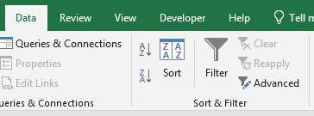
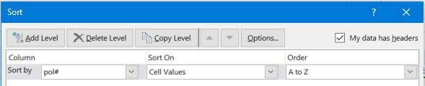
Filtering
Excel: Functions Part 4 ~ Filtering and Sorting (regular and custom sort)
Select any cell in the column header for your desired filtered table, then use your keyboard shortcut or click on “Filter” in the Data ribbon tab. To use the filter, open the dropdowns.
Sorting
There are several ways to get to sorting capabilities: using the dropdown of the filter in your table, using the “Sort” buttons on the Data ribbon tab, highlighting a range of cells and right-clicking and selecting “Sort”.
Usually, you will want to sort where the rest of a table adjusts accordingly (keeping the rows the same, but in a different order). Sometimes, however, you may want to only adjust a portion of the data, leaving everything else in the row the same.
You would use custom sort for this.
3

Slide 4
VALUE(text)
Excel: Functions Part 4 ~ VALUE, TEXT, LEFT, RIGHT, and MID
Turns the given text-filled cell into a value, if possible
TEXT(value, format_text)
Turns the given value-filled cell into a text, given the specific text format desired. There are A LOT of different text formats. (e.g. “0,000.00” or “mm/dd/yyyy”) See HERE for further examples.
LEFT(text, num_chars)
Returns the given number of characters from a cell, counting from the left (be careful of leading spaces!)
_{RIGHT(text, num_chars)} Returns the given number of characters
from a cell, counting from the right (be
careful of trailing spaces!)
MID(text, start_num, num_chars)
Returns the given number of characters from a cell, counting from a given starter position. (e.g. A5 contains 1234567 MID(A5,3,2) = 34)

Slide 5
DATE(year, month, day)
Excel: Functions Part 4 ~ DATE, YEAR, MONTH, and DAY
Creates a value in date format, given year, month, and day values. These could be manually given or pulled from other portions of cell values using other functions.
YEAR(serial_number)
Returns the year from a date format, which is stored in the Excel metadata as a serial number (i.e. the date format displays this serial number in a format we are used to seeing).
MONTH(serial_number)
Returns the month number from a date format.
DAY(serial_number)
Returns the day number from a date format.

Slide 6
FIND(find_text, within_text, start_num)
Excel: Functions Part 4 ~ FIND and LEN
What you are looking for in the string – the FIND function will return the position number
Location of the string
Starting position in the string after which to search (most of the time you will not enter this because you most often start at the beginning of the string)
i.e. “The FIND function will return the position number of a particular text you are looking for in a given text string”
LEN(text)
Returns the numerical length of a given string

